Slide 1

Automatic Segmentation of Plant Leaves Disease Detection
STUDENT NAME: UZUM STANLEY EKENE
STUDENT ID: UZU22571175

Slide 2
CONTENTS
Background
Problem Definition
Proposed methodology
Data Selection
Refereces

Slide 3
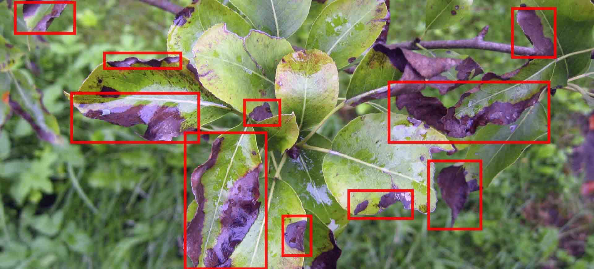
1 Background
Preprocessing
Disease Spot Detection
The study of automatic segmentation of plant leaf diseases is an emerging field that addresses the need for efficient and accurate disease detection in agriculture. This research is particularly relevant given the global push towards precision agriculture, where technology is leveraged to increase crop yield and reduce waste.
The approach outlined on this focuses on the automatic segmentation of diseased areas from plant leaf images. This process is crucial as it enables the subsequent application of machine learning algorithms, which can significantly enhance the accuracy of disease detection systems.
Segmentation and Analysis

Slide 4

2 Problem Definition
The agricultural sector is increasingly seeking innovative solutions to enhance crop health and yield.
A critical challenge within this domain is the early and accurate detection of plant diseases, which
can significantly impact productivity. Traditional methods of disease detection often rely
on manual inspection, which is labor-intensive, time-consuming, and prone to
human error. Moreover, these methods may not be scalable or
cost-effective for large-scale farming operations.
This research aims to address these limitations by developing an automated, cost-effective solution for the segmentation of plant diseases from leaf images. The core objective is to eliminate the need for human intervention at any stage of the detection process, thereby streamlining operations and reducing the potential for inaccuracies.
The proposed solution employs a Min-Max Hue Histogram technique in conjunction with k-means clustering to accurately segment diseased regions from healthy leaf tissue. This method is designed to be more precise than existing approaches, leveraging the strengths of color-based segmentation to identify disease spots effectively.
Furthermore, the research seeks to enhance the accuracy of disease detection by integrating the segmented data with advanced machine learning or deep learning algorithms. By doing so, the system can learn from a vast array of data points, improving its diagnostic capabilities over time.
In summary, the problem this research tackles is the development of a reliable, automated system for plant disease detection that is both accessible and efficient, with the potential to revolutionize disease management in agriculture and contribute to the sustainability of food production systems worldwide.

Slide 5
3 Proposed Methodology
Disease spot identification on HSI model
K-means and Hue based Segmentation
To effectively detect and isolate disease spots, a methodology leveraging the hue component of the image is essential. This component, indicative of color purity, facilitates clearer recognition of the specific color associated with leaf diseases, thereby enabling straightforward detection and isolation processes.
In the third phase, the image undergoes segmentation into multiple clusters via K-means clustering applied to the L*a*b* color space, yielding diverse clusters. Subsequently, the task entails identifying the cluster that encompasses the diseased regions. Leveraging the advantageous properties of the HSI color model, which facilitates the straightforward identification of objects based on specific colors while mitigating external light intensity effects, all clusters are transformed from the RGB to the HSI color model. Notably, we observed that the disease cluster tends to exhibit a higher mean hue value compared to other clusters. Consequently, clusters displaying elevated mean hue values are designated as disease clusters, and a corresponding mask is generated. Utilizing this mask, disease spots are segmented from the original plant
Title text addition
Fuzzy Rank Order Filter
The envisioned color image filtering system encompasses several key components: impulse noise prediction and detection, the ROF filter, and pixel reconstruction stages. Given that color images comprise three distinct color channels—Red, Green, and Blue—the filtering process is applied individually to each channel. Subsequently, the outcomes from each channel are amalgamated to yield the ultimate denoised image.

Slide 6
3.1 Proposed Methodology Circle
The proposed research emphasizes the development of a fully automated disease segmentation system characterized by its high accuracy. The benefits of the proposed algorithm are multifaceted and can be summarized as follows:
User Independence
Noise Reduction
Unlike existing methods that depend on user input for image segmentation, the proposed system operates autonomously, requiring no manual intervention.
It effectively eliminates digital noise, thereby enhancing the visualization of disease spots, surpassing the capabilities of current techniques.
Pre-Segmentation Identification
Title text addition
By employing a hue histogram technique for disease spot identification before segmentation, the algorithm ensures precise segmentation through k-means clustering.
Segmentation Accuracy
The algorithm achieves a level of segmentation precision that outperforms existing methodologies.
Algorithmic Improvement
The proposed algorithm contributes to the overall improvement in segmentation accuracy.

Slide 7
3.2 Image denoising using rank order fuzzy filter
The Rank Order Fuzzy (ROF) filter represents a sophisticated technique in image processing, particularly adept at enhancing images plagued by impulse noise, which is prevalent in highly corrupted environments. The efficacy of the ROF filter stems from its unique approach to noise management, which is predicated on the ranking and density analysis of the noisy pixels within an image. The procedural execution of the ROF filter unfolds through a series of methodical steps, detailed as follows:
Noise Ranking: Initially, the algorithm assesses the image to determine the density of the noise present. This involves ranking the pixels based on the level of corruption detected.
Fuzzy Logic Application: Subsequently, fuzzy logic principles are applied to these ranked pixels. This step is crucial as it helps in differentiating between noise and actual image content.
Filtering Process: The core of the ROF filter’s operation lies in its ability to process the image based on the rankings established. It selectively targets the noisy pixels for treatment while preserving the integrity of the original image data.
Image Enhancement: The final outcome of the ROF filter application is a significant improvement in image quality. The processed image exhibits reduced noise levels, leading to clearer and more accurate visual representations.
In essence, the ROF filter is a powerful tool in the realm of image processing, offering a robust solution to the challenge of impulse noise without compromising the image’s original details. Its step-by-step procedure ensures a meticulous approach to noise reduction, resulting in enhanced image clarity and quality.
01
02
04
03

Slide 8
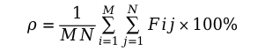
3.3 Impulse noise detector & density predictor
Build a two-dimensional index matrix Fij with element values of 0 or 1. The procedure for determining the value of index 0 or 1 in each index matrix Fij is as follows:
Create a (2M × 1)(2M × 1) neighborhood region with Pij as the center for each pixel Pij at position (i, j) in the picture.
If Pij equals 0 or 255, then Pij is a corrupted pixel, and the value of Fij should be set to 1.
If Pij is between 0 and 255, then Pij could be an uncorrupted pixel. So, determine whether or not it is corrupted. To do so,
first translate the window into a 1-D vector S and then sort the elements of S in ascending order.
01
02
If S(⌊α/2⌋ + 1) ≤ Pij ≤ S(n − (⌊α/2⌋)) where αan integer and 0 ≤ α ≤ n then Pij is an uncorrupted pixel, and the value of Fij is set to 0. Otherwise, the pixel is mutated, and the value of Fij is set to 1.
Calculate the percentage of impulse noise forecast using the following formula:
$$ρ=\frac{1}{MN}\sum_{i=1}^{M}{\sum_{j=1}^{N}{Fij}}×100\%$$
04
(1)
03
Denoted:
ρ is the percentage of impulse noise prediction
Fij is index matrix 2D at coordinate (i, j)
M is the total of rows and N is the total of columns.

Slide 9
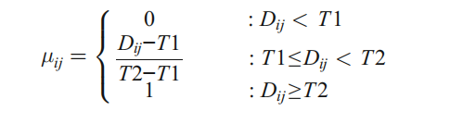




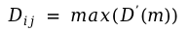

3.4 Rank order fuzzy filter
Set the value of each noise element, where “salt or 255” by “0”. So that Pij only has one noise model that is “pepper or 0”. If Pij is an uncorrupted pixel then its value is left unchanged. Otherwise, follow the following step:
Select 2-D window of size(2M × 1) (2M × 1). Assume that the pixel being filtered isPij.
Matrix elements of the window should be sorted starting from the smallest value to the largest value. If the selected window contains all elements as 0’s then increase the window size by one and again check the increased window. If increased window contains all 0’s, then again increase window size by one. This process is repeated until we have a window with some element (except 0) on it or the maximum window size limit is reached.
Eliminate the 0 from the window and find the average and median of the remaining pixels. Suppose average and median is denoted by Aij and Mij.
Calculate first order absolute differences D′(i + k, j + l) by:
01
02
(2)
$D^{’}(i+k,j+l)=\left|p_{i+k,j+l}−P_{ij}\right|$ with k, l ≠ 0
Extract the local information Dij from Wij according to:
$$D_{ij} = max(D^{’}(m))$$
04
Compute the fuzzy membership value μij based on the local information Dij
$$μ_{ij}=\left\{\begin{aligned}0 \\ \frac{D_{ij−T1}}{T2−T1} \\ 1\end{aligned}\right.$$
$${:D}_{ij}<T1$$
03
$${:T1≤D}_{ij}<T2$$
(3)
$${:D}_{ij}≥T2$$
Where, T1 and T2 are two predefined thresholds.

Slide 10
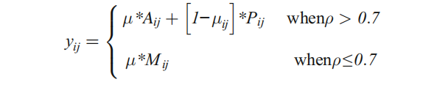
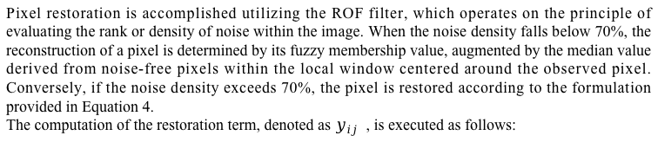
3.5 Pixel restoration
Pixel restoration is accomplished utilizing the ROF filter, which operates on the principle of evaluating the rank or density of noise within the image. When the noise density falls below 70%, the reconstruction of a pixel is determined by its fuzzy membership value, augmented by the median value derived from noise-free pixels within the local window centered around the observed pixel. Conversely, if the noise density exceeds 70%, the pixel is restored according to the formulation provided in Equation 4.
The computation of the restoration term, denoted as $y_{ij}$ , is executed as follows:
01
02
(4)
04
03

Slide 11
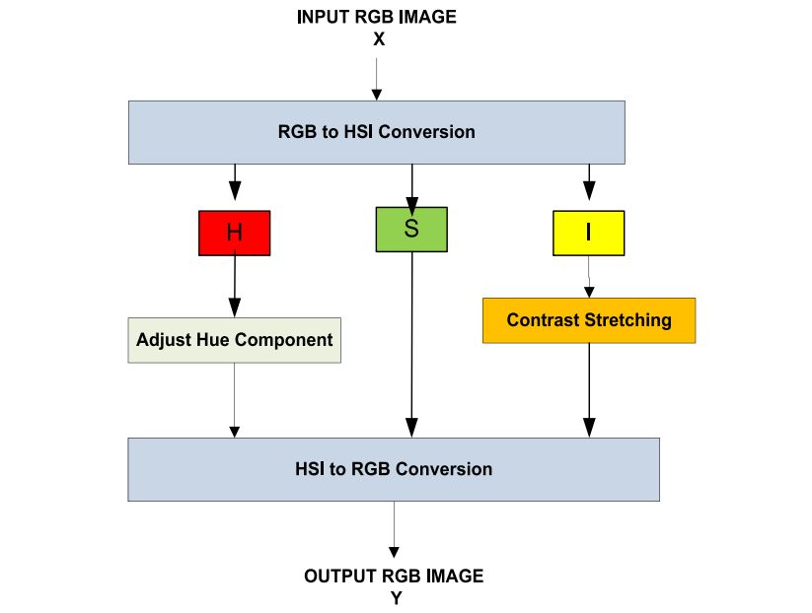
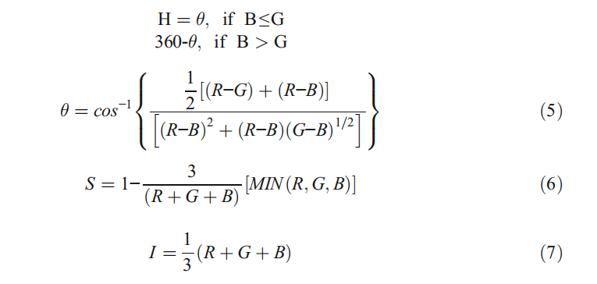
4 Hue based disease spot identification
Below are the delineated steps of our proposed hue-based disease spot identification method, aimed at offering a comprehensive framework for identifying and analyzing disease spots within the dataset, facilitating effective disease management and crop health monitoring strategies.
The components of image X in RGB format are delineated as follows, with particular
focus on the H component.
Rank order fuzzy filter
Pixel restoration
Title text
The range of intensity and hue are [0, 1] and [0,360], respectively
and The range of saturation is from [0,1].

Slide 12
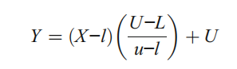
4.1 Contrast stretching on I component
Contrast stretching, a fundamental technique in point processing, enhances an image's dynamic range by amplifying its contrast, effectively darkening darker pixels and brightening the brightest ones. This method is incorporated into the I component post the conversion to the HSI color model, globally augmenting the intensity factor.
Initially, this process involves defining upper (U) and lower (L) limits, determining the range within which image intensity values can be expanded. Subsequently, the histogram of the original image is analyzed to establish precise value limits (lower = l, upper = u) for the unaltered image.
The function is given as:
Contra ((((8st stretching on I component
(8)
HSI to RGB conversion
Equation 8 provides the mapping from the original pixel value X to the corresponding output value Y. This mapping process is executed individually for every pixel in the image, facilitating the transformation of each pixel's intensity according to the specified equation.

Slide 13
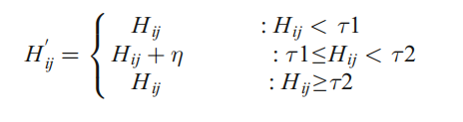
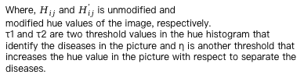
4.2 H component based disease spot detection
Hue, a vital component within the HSI color model, is quantified on a scale from 0 to 360 degrees, symbolizing the color's position on the color wheel. Progressing from red through orange, yellow, green, cyan, blue, magenta, and back to red, the hue value encapsulates the spectrum of colors. Adjusting the hue serves to accentuate the color of the leaf disease, necessitating a methodology for identifying and isolating the affected areas. Therefore, establishing a threshold value that discerns disease spots from healthy plant tissue is imperative.
This is achieved by computing the histogram of the hue component and pinpointing the highest and lowest peak points within the 0 to 60-degree range, as this interval typically encapsulates most disease-related hues based on prior experimentation. These identified points, denoted as τ1 and τ2, are employed as threshold values.
Subsequently, the hue value is modified to enhance the discernibility of disease spots within the leaf image, thereby optimizing the information available for disease detection and isolation.
(9)
Where, $H_{ij}$ and $H_{ij}^{’}$is unmodified and
modified hue values of the image, respectively.
τ1 and τ2 are two threshold values in the hue histogram that identify the diseases in the picture and η is another threshold that increases the hue value in the picture with respect to separate the diseases.

Slide 14
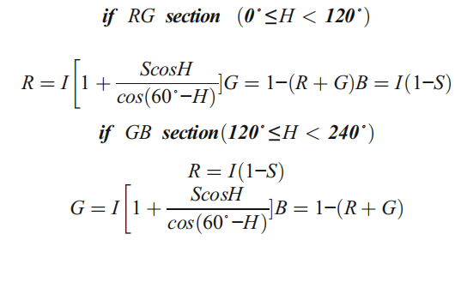
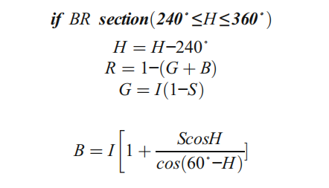
4.4 HSI to RGB conversion
Integrate the adjusted H component, the unaltered S component, and the refined I component to generate the ultimate enhanced HSI color image. Subsequently, transform this enhanced HSI color map back into the RGB color map to derive the final enhanced image. Following this procedure, the conversion from HSI to RGB color space is executed to showcase the enhancement outcome. An inverse conversion algorithm can be articulated accordingly.
Fuzzy Rank Order Filter
(10)
Disease spot identification on HSI model
(11)
K-means
Hue based Segmentation
(12)

Slide 15
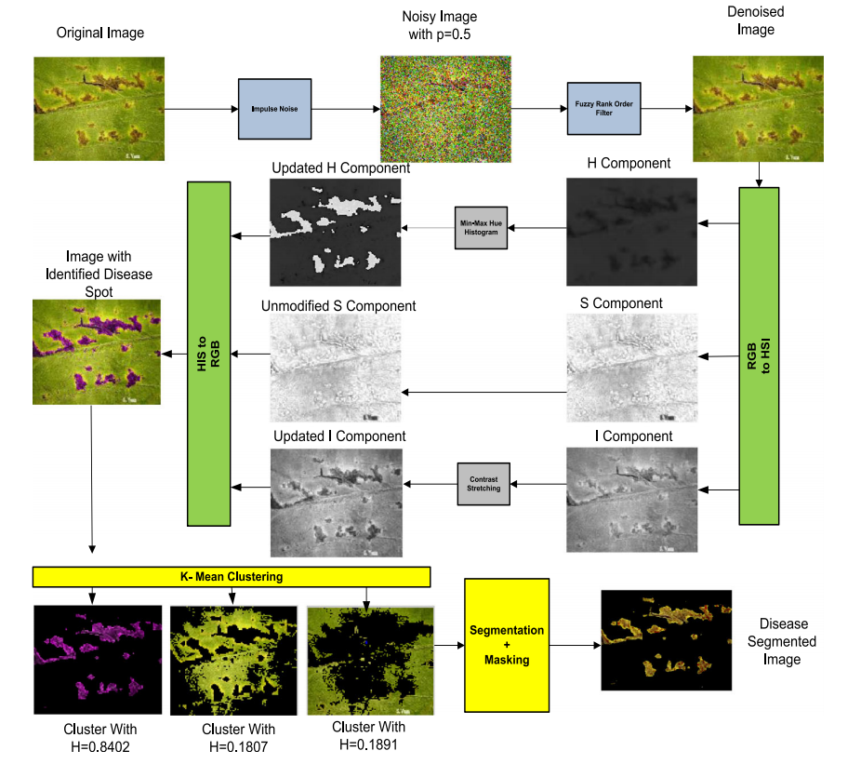
Flow chart of proposed algorithm
Fuzzy Rank Order Filter
Disease spot identification on HSI model
K-means
Hue based Segmentation

Slide 16
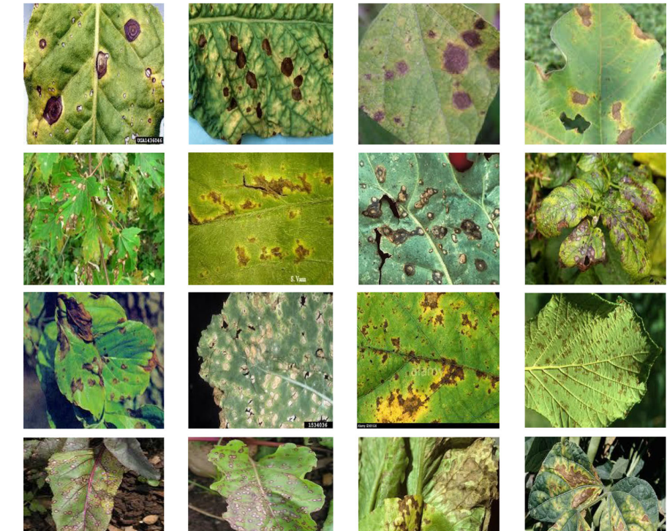
5 Dataset Overview
The datasets used for this work were downloaded from plant village dataset (https://plantvillage.org).
In our experimental setup, we curated a dataset comprising 73 distinct crop leaf images. Among these, 15 images depict healthy leaves, while the remaining images exhibit various leaf diseases. The diseased leaf images are categorized into distinct classes, including bacterial blight, alternaria alternate (also recognized as fungal), cercospora leaf spot, and anthracnose.
Fuzzy Rank Order Filter
Disease spot identification on HSI model
K-means
Hue based Segmentation

Slide 17
References
Al D, Bashish BM, Bani-Ahmad S (2010) A framework for detection and classification of plant leaf and
stem diseases. In: 2010 International Conference on Signal and Image Processing, pp 113–118
Fuzzy Rank Order Filter
Archana KS, Sahayadhas A (2018) Automatic rice leaf disease segmentation using image processing
techniques. Int J Eng Technol 7:182–185
Disease spot identification on HSI model
K-means
Hue based Segmentation

Slide 18
THANK YOU

